Slide 1







STACK OVERFLOW DEVELOPER SURVEY 2019
Md. Abu Dayan Siddik
August 16, 2024

Slide 2



OUTLINE
Executive Summary
Introduction
Methodology
Results
Visualization – Charts
Dashboard
Discussion
Findings & Implications
Conclusion
Appendix

Slide 3

EXECUTIVE SUMMARY
JavaScript and HTML are the most popular Web-based languages.
MySQL is the most used database, but the popularity of PostgreSQL and MongoDB are increasing.
Windows and Linux still dominate all developing platforms while docker’s popularity is increasing.
For the mobile platform, Android wins by no contest.
jQuery is one of the most popular web frameworks but is losing its popularity when React.js is gaining noticeably.
Most Developers are men, residing in the USA, in late adolescence/young adulthood, and bachelor’s degree holder

Slide 4

INTRODUCTION
The technology market changes quickly every year.
It is important to catch up with the latest technology in each field.
The comparison between current and next year's technology trends will provide a great inside of the market.
The study consists of 5 main parts:
Top 10 Languages (Current, Future)
Top 10 databases (Current, Future)
Top platforms (Current, Future)
Top 10 web frameworks (Current, Future)
Respondents
Gender
Country
Age
Education Level

Slide 5

METHODOLOGY
The data is collected from the ‘Stack Overflow Developer Survey 2019’.
The technology trend is studied by comparing current and future technology usage.
Respondents’ gender, country, age, and education level are studied from demographics
Different charts, such as bar, column, line, pie, treemap, and word cloud are used to visualize the result.
The Google Looker Studio dashboard is used to analyze data and create visualization.

Slide 6

RESULTS
The results consist of 4 main parts:
Programming language trend
Database trend
Platform trend
Web frame trend

Slide 7
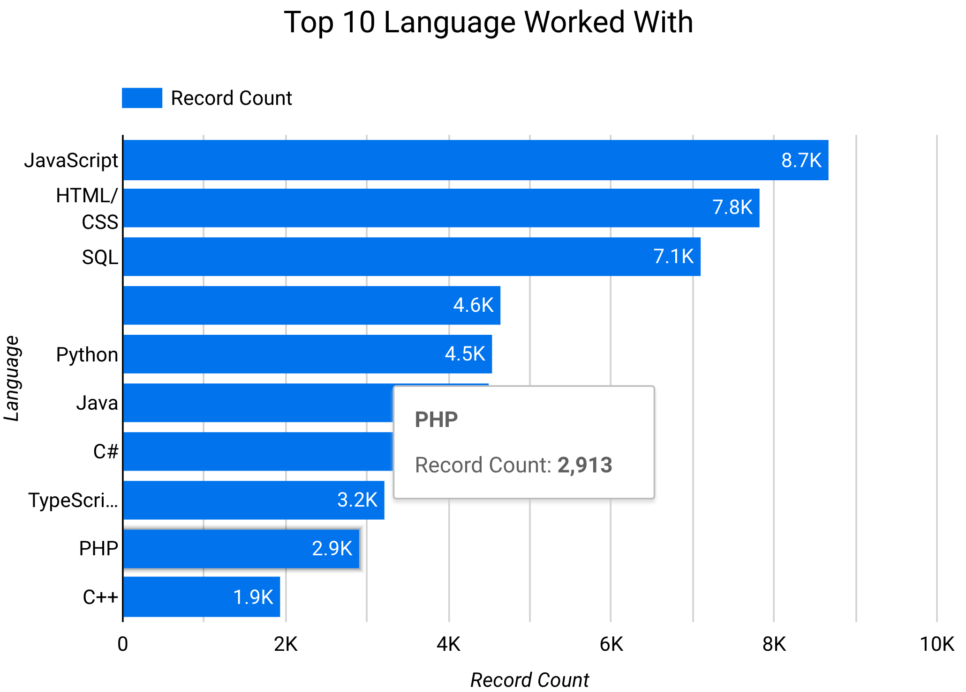
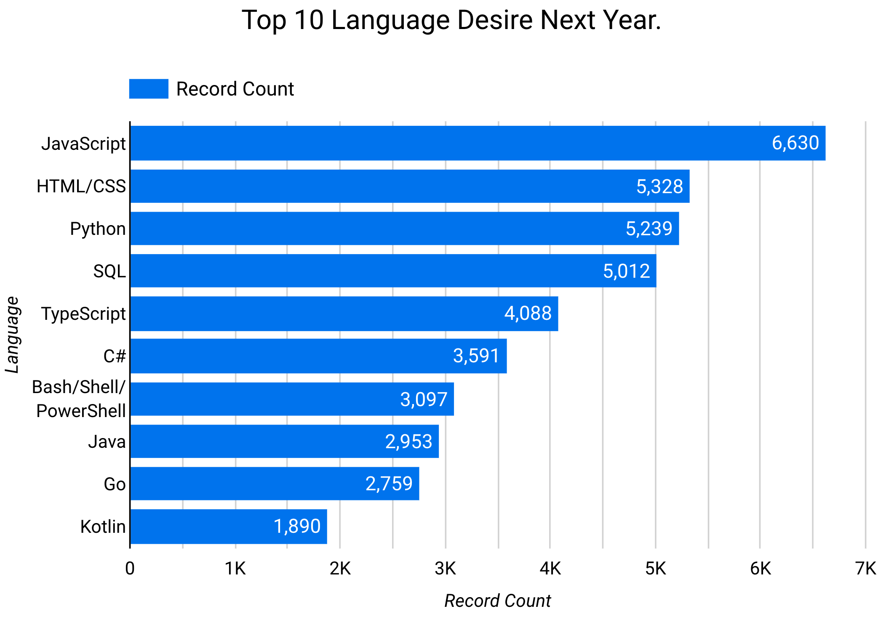
PROGRAMMING LANGUAGE TRENDS
Current Year
Next Year

Slide 8
PROGRAMMING LANGUAGE TRENDS - FINDINGS & IMPLICATIONS
Findings
JavaScript & HTML/CSS are top programming languages for both current and future trends.
Python moves from 5th position to 3rd position in top 10.
Java moves from 6th to 8th position.
C++ and PHP are disappearing from the top 10.
Implications
Web programming languages will stay dominant shortly.
Python and data science are becoming more and more dominant.
Legacy languages such as C++ and PHP are gradually falling out of interest.

Slide 9
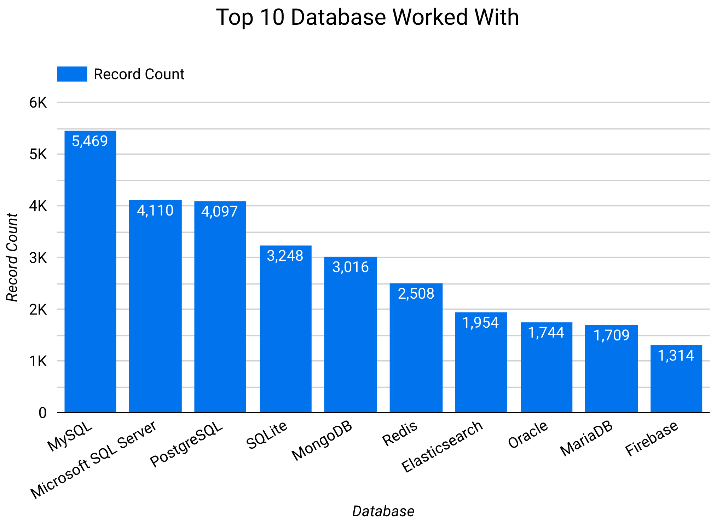
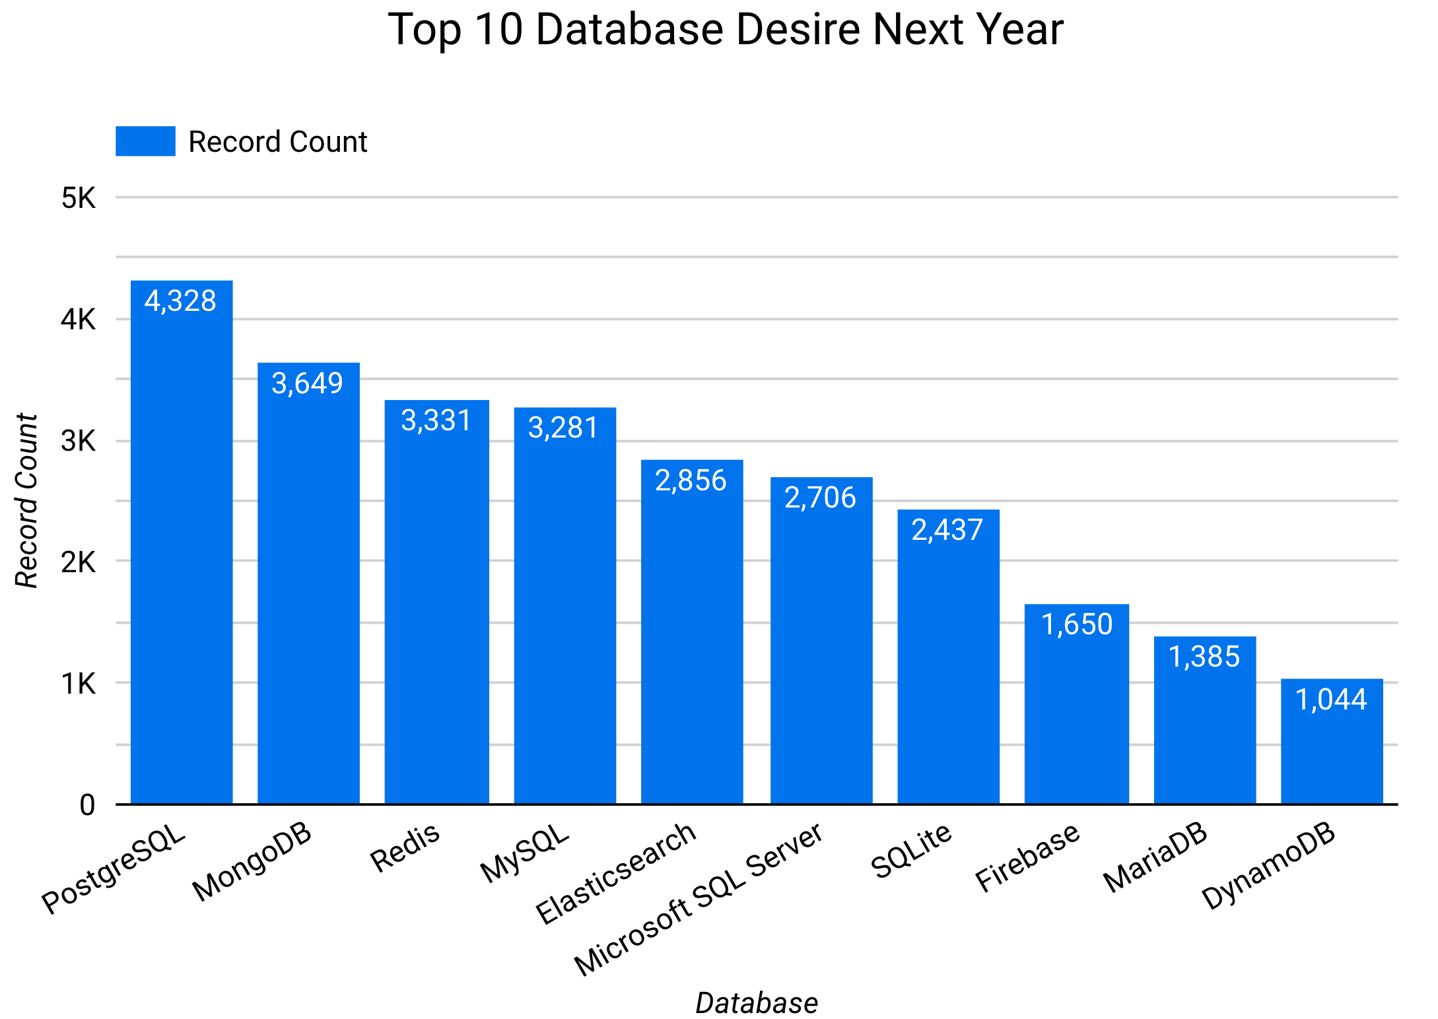
DATABASE TRENDS
Current Year
Next Year

Slide 10
DATABASE TRENDS - FINDINGS & IMPLICATIONS
Findings
PostgreSQL moves from No.3 to No.1
MongoDB & Redis quickly moves up to No.2 and No.3
MySQL and MS SQL server drops respectively from No.1 to No. 4 and No.2 to No.6
Oracle disappear from top
Implications
Open source databases become more and more popular compared with commercial ones.
Non-relational databases seem increasing usage in the future.
Relational database will take a leading position shortly.

Slide 11

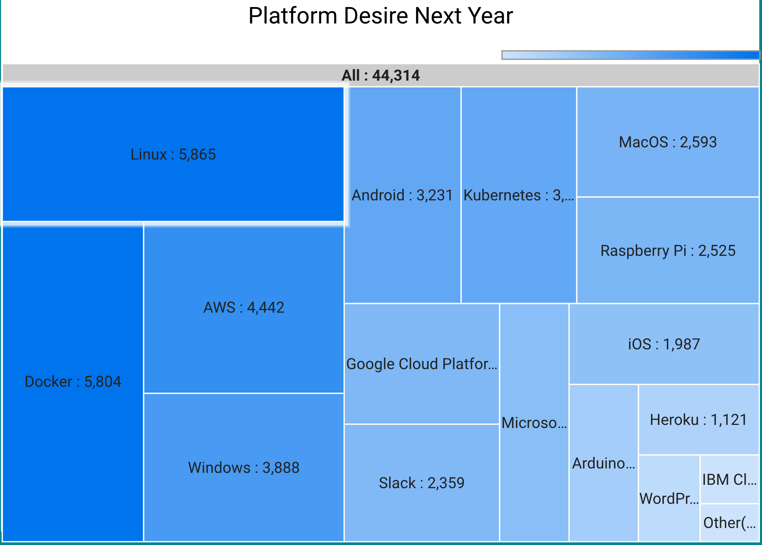
PLATFORM TRENDS
Current Year
Next Year

Slide 12
PLATFORM TRENDS - FINDINGS & IMPLICATIONS
Findings
Windows and Linux still dominate the platform trend.
Android is the No.1 mobile platform.
Cloud platforms such as Kubernetes, Docker, and AWS are getting market share gradually.
Implications
Windows and Linux are still the main developing platforms in the foreseeable future.
The transformation to cloud computing is a non-reversible process.

Slide 13
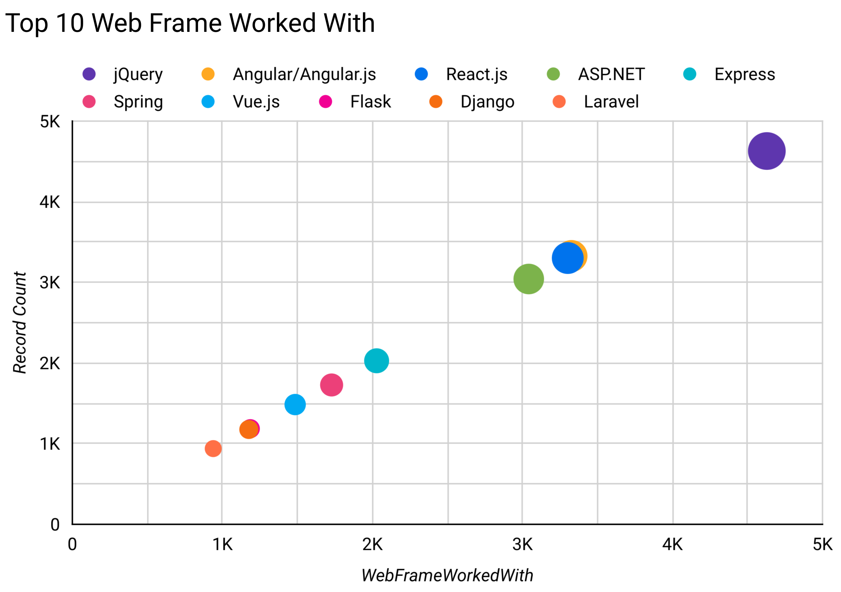
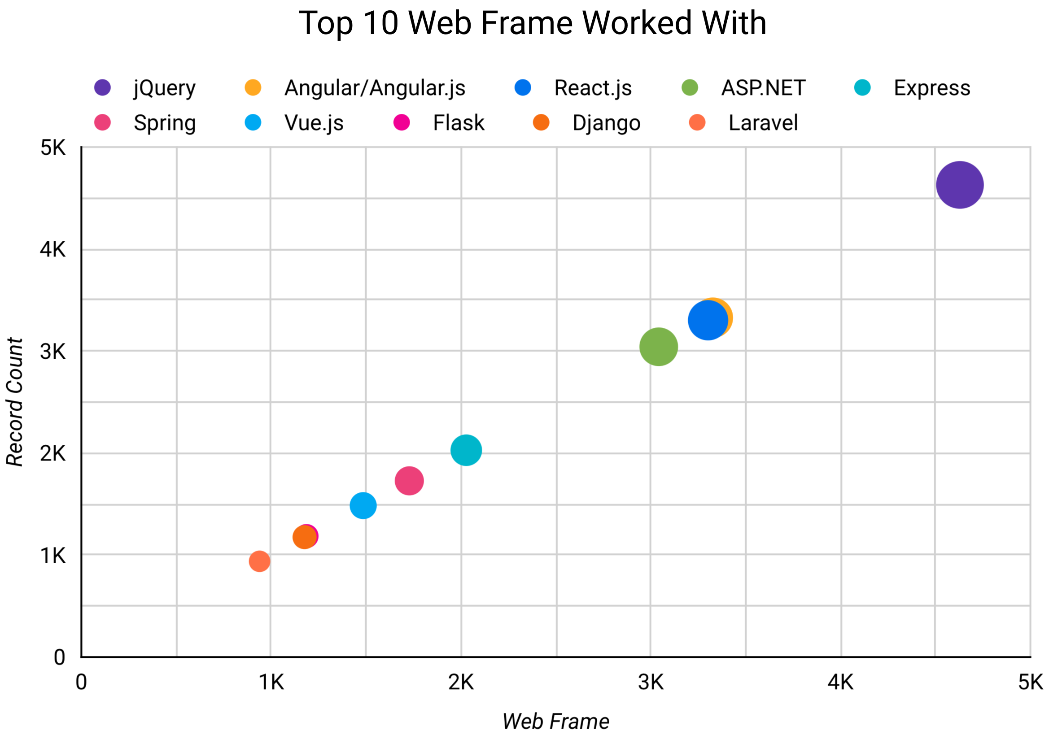
WEB FRAME TRENDS
Current Year
Next Year

Slide 14
WEB FRAME TRENDS - FINDINGS & IMPLICATIONS
Findings
jQuery decreases from No.1 to No.4.
React.js moves up from No.3 to No.1
Vue.js moves from No.9 to No.3.
Angular.js stays in the same position.
Implications
jQuery quickly loses market share since showing a lack of interest in its future development.
React.js and Vue.js become the new standard for web frame development.

Slide 15
DASHBOARD
<https://github.com/Dayan94/IBM-Data-Analyst-Professional-Certificate/blob/main/README.md.>

Slide 16
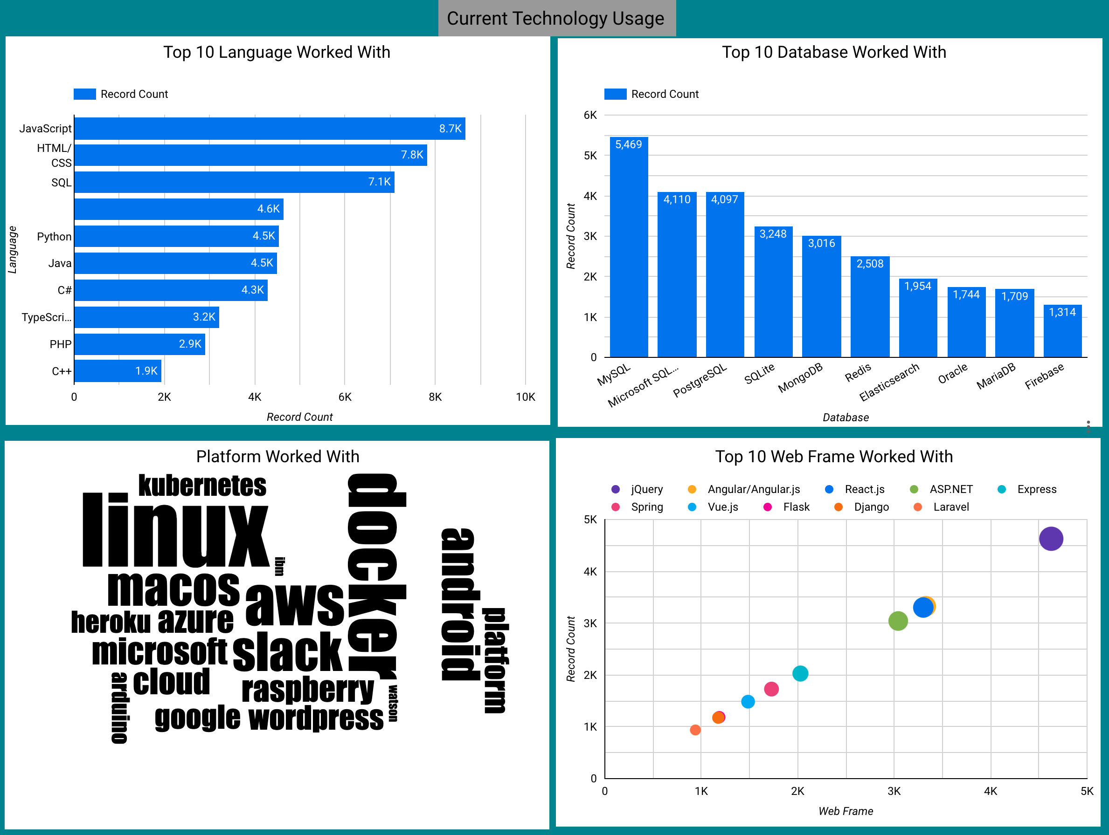
DASHBOARD TAB 1

Slide 17
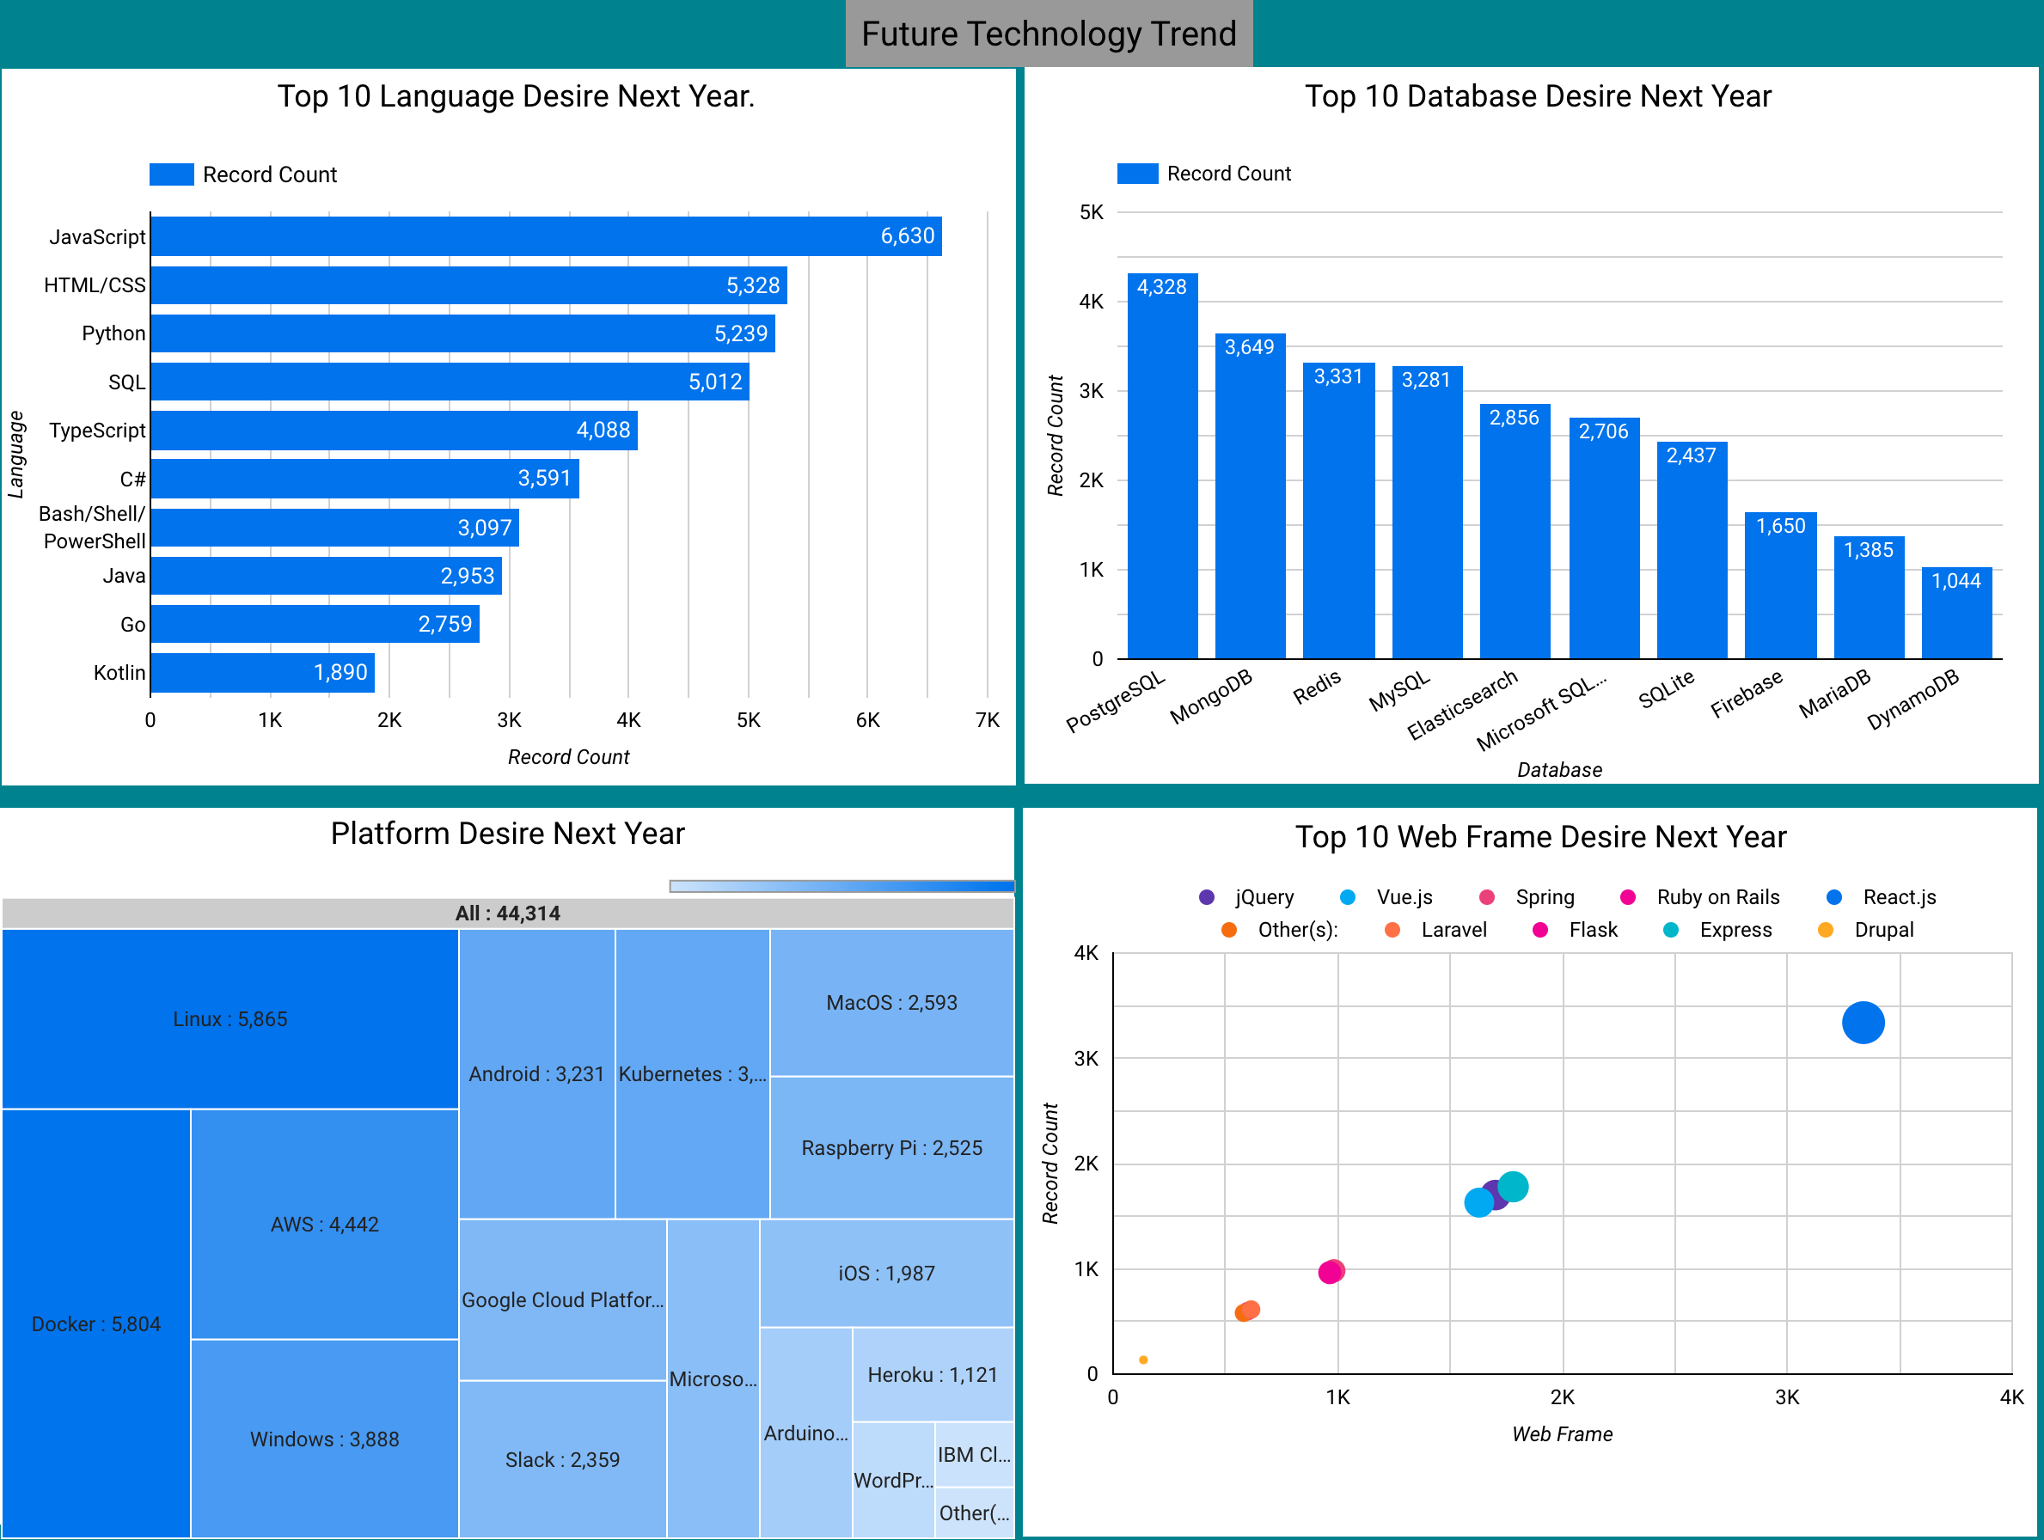
DASHBOARD TAB 2

Slide 18
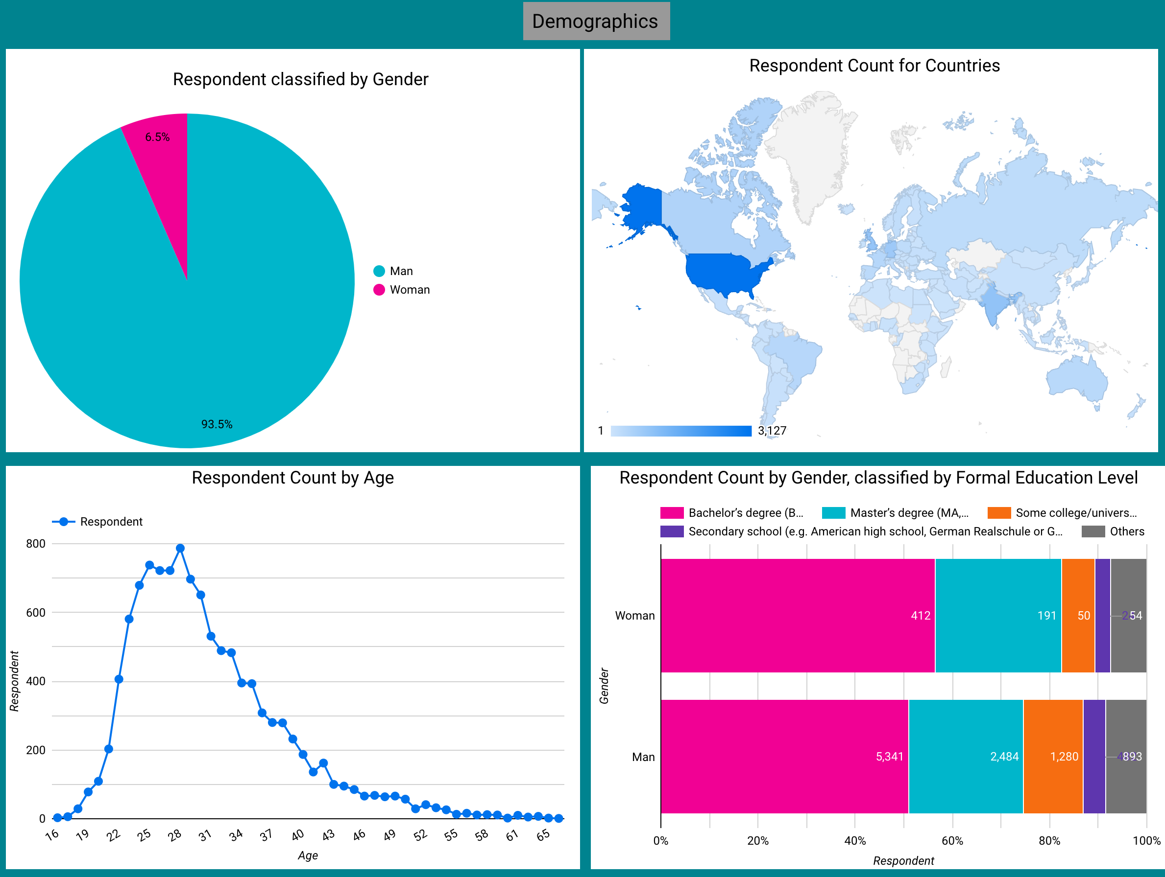
DASHBOARD TAB 3

Slide 19
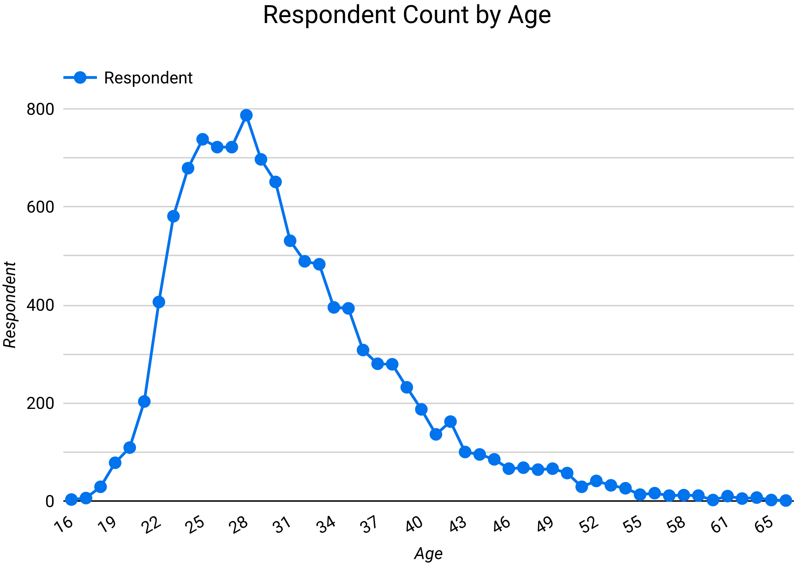
DISCUSSION
The majority of respondents are young (20, 30), which could skew the result in favor of new technology.

Slide 20
OVERALL FINDINGS & IMPLICATIONS
Findings
Web-based language stays at No.1
Non-relational database moves to No.2 & No.3
Cloud-based platform moves to No.1
React.js will lead at No.1 on the web framework
The man-woman percentage gap is pretty huge, 93.5% and 6.5% respectively
Implications
Web-based applications are taking over the traditional application.
Non-relational database shows increasing adoption.
Cloud-based services become the top choice for platform development.
Men are more prone to become developers than women

Slide 21

CONCLUSION
To stay relevant in the technology field, it’s important to learn web-based language & non-relational databases.
Among web frameworks, React.js is the best to learn for your future.
Cloud-based service is the right direction for IT investment.
Women should participate more in the development sector to mitigate the huge gap in the man-woman percentage.

Slide 22
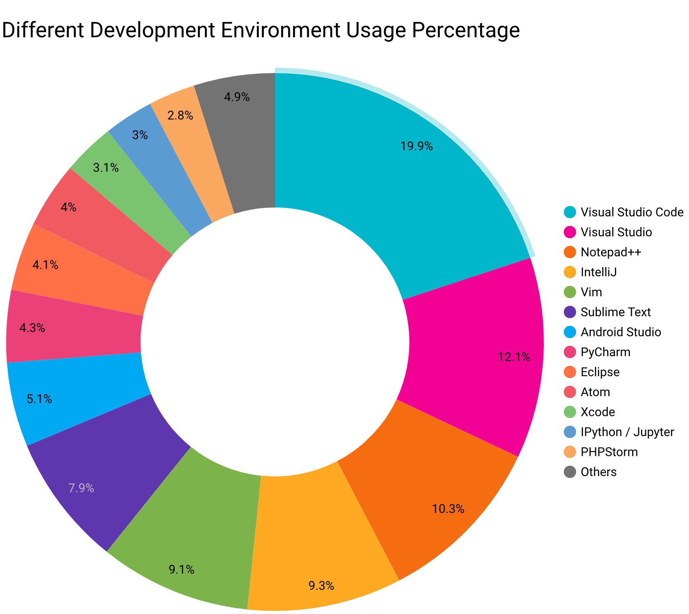

APPENDIX

Slide 23
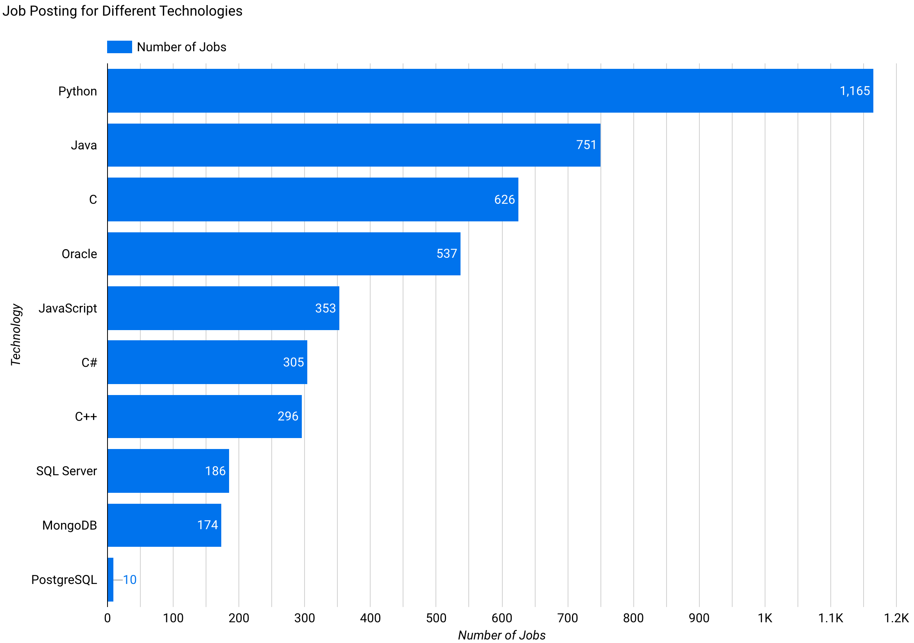
JOB POSTINGS

Slide 24
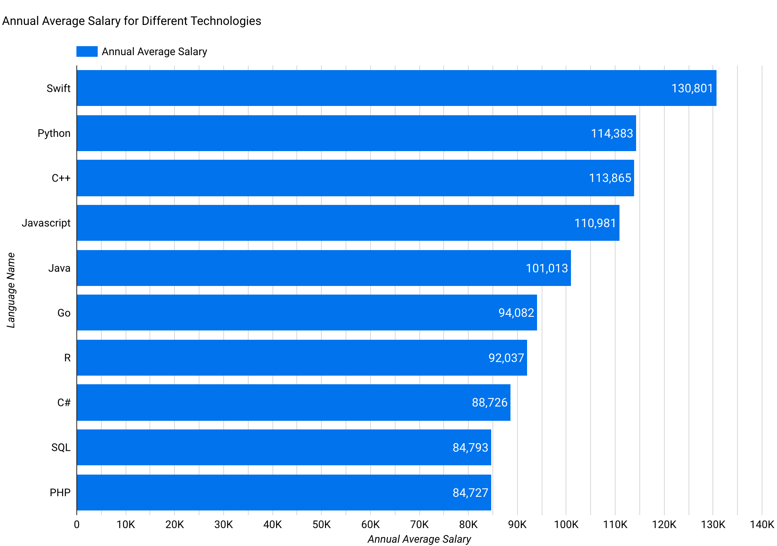
POPULAR LANGUAGES

